Slide 1

Digital Portfolio
Student Name: Sathiyamoorthi. K
NMID: asbru001224BIT243
Department: Information Technology
College: Government Arts College, Coimbatore – 18 (Bharathiar University

Slide 2

Project Title
My First Website – SKScoders (Neocities)

Slide 3

Agenda
1. Problem Statement
2. Project Overview
3. End Users
4. Tools and Technologies
5. Website Design and Layout
6. Features and Functionality
7. Results and Screenshots
8. Conclusion
9. GitHub / Website Link

Slide 4

Problem Statement
In the digital era, students need a platform to share coding resources, tutorials, and projects.
Traditional learning is often:
Textbook-heavy
Lacking interactivity
Limited in accessibility
There was a need for a beginner-friendly website to share coding knowledge.

Slide 5


Project Overview
The project is my first personal website created on Neocities.
Acts as a learning platform for programming concepts.
Provides coding tutorials, examples, and resources.
Serves as a foundation for my web development journey.

Slide 6
End Users
Students – to learn coding basics
Beginners in programming – to access tutorials
Faculty and peers – to review and share resources
Myself – to practice and showcase web development skills

Slide 7
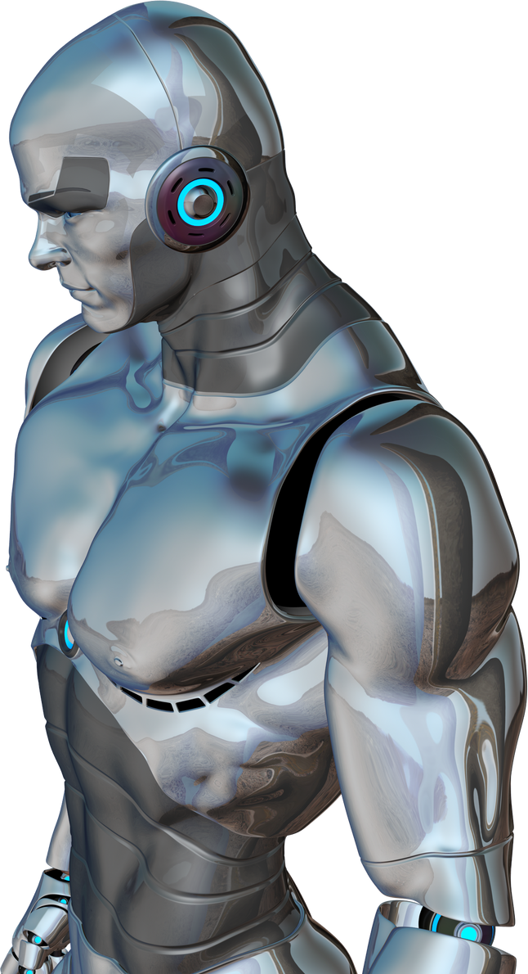
Tools and Technologies
HTML5 – Structure and Content
CSS3 – Styling and Layout
JavaScript – Interactivity
Neocities Hosting – Free online web hosting

Slide 8

Website Design and Layout
Simple and easy-to-navigate design
Sections include:
Home Page
About / Introduction
Coding Tutorials
Contact Info
Clean and minimal styling for readability

Slide 9

Features and Functionality
Basic home page with introduction
Section for coding tutorials and examples
Navigation links for smooth movement
Simple, lightweight, and accessible from any device

Slide 10
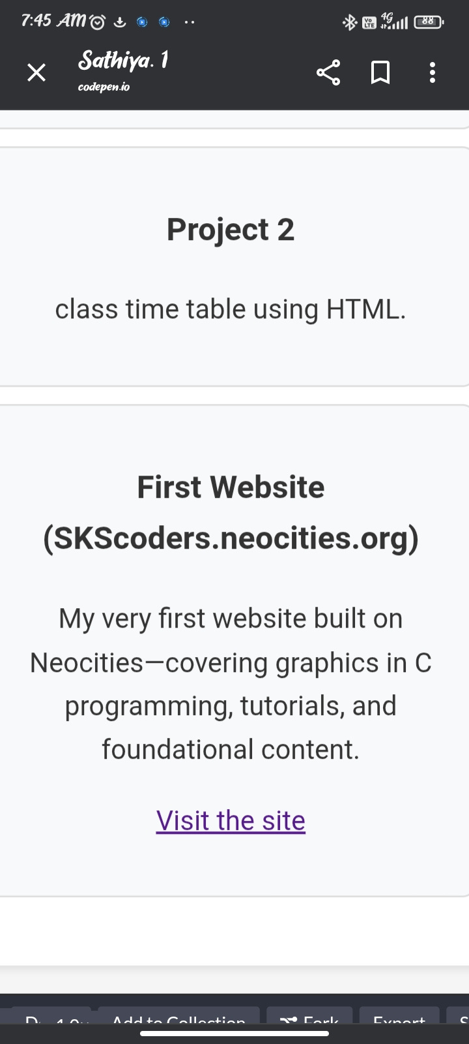
Result and screen shot
Result and screen shot

Slide 11




Conclusion
My first step into web development
Helped me learn HTML, CSS, and hosting
Showcases my ability to create and publish a live website
Foundation for future advanced projects

Slide 12



GitHub link
https://github.com/s34031908-cpu/Sathiyamoorthi.git
Thank you

